Slide 1
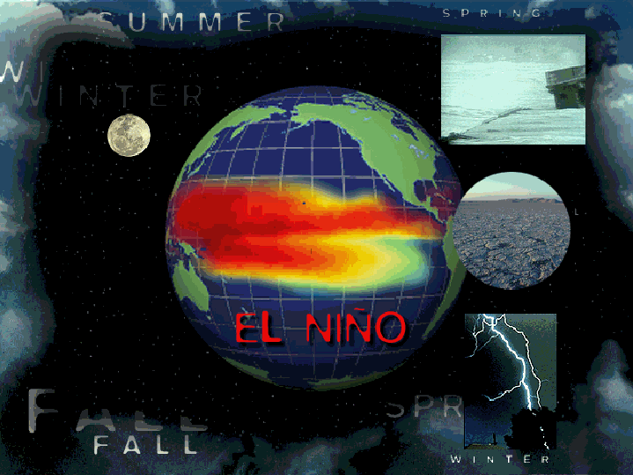

Notes:
1
1
1

Slide 2
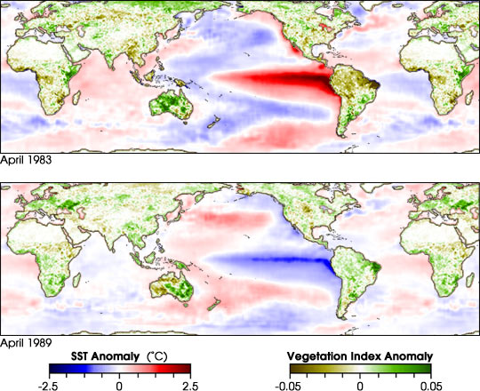
El Niño and La Niña

Slide 3
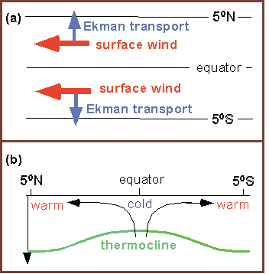
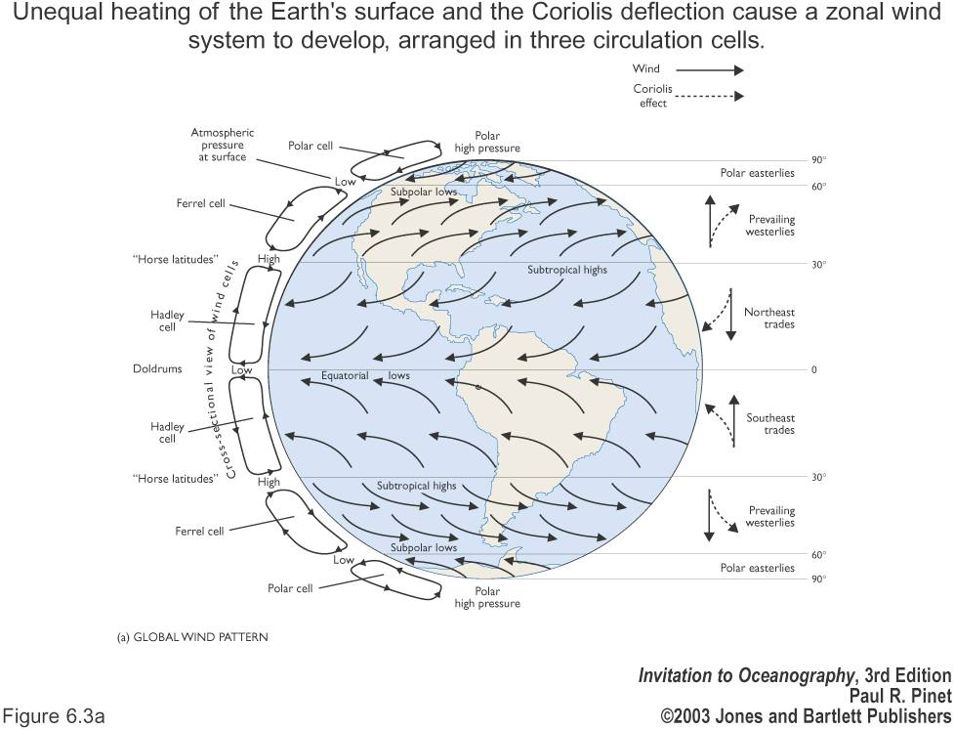
simplified..why cold water at the equator!

Slide 4
El Nino/Southern Oscillation (ENSO)
Climate:
Variability (Natural modes, times scales of interannual, decadal, centennial, millenial)
Change (anthropogenic) – search for trend that is attributable to external forcing
ENSO is an interannual climate variation
3-7 year time scale, not predictable (chaotic process with underlying physics that creates repetition that is not precisely cyclic)
Coupled ocean-atmosphere interaction with feedback (coupling is strong in tropics, weak at higher latitudes)
Nearly global impacts, certainly in the tropics
Strongest impacts in eastern tropical Pacific - Peruvian upwelling, eastern tropical surface temperatures, tropical rainfall

Slide 5
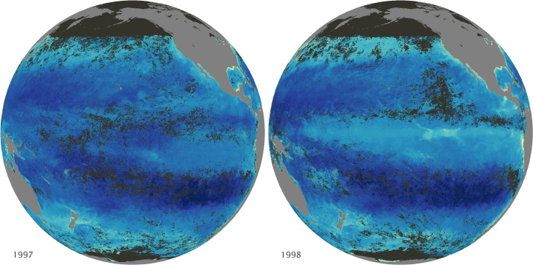
ENSO effect on surface chlorophyll
El Nino La Nina
http://earthobservatory.nasa.gov/Features/Phytoplankton/page4.php
Equatorial upwelling brings nutrients to sea surface, enhanced in cold tongue in the mean; upwelling from warm, nutrient depleted water during El Nino

Slide 6
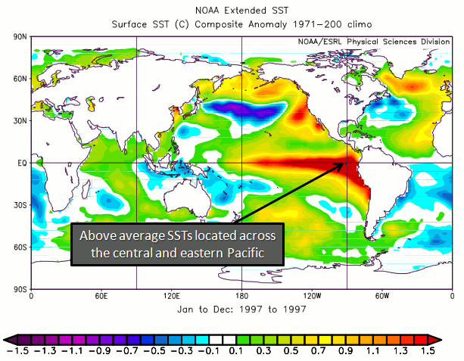
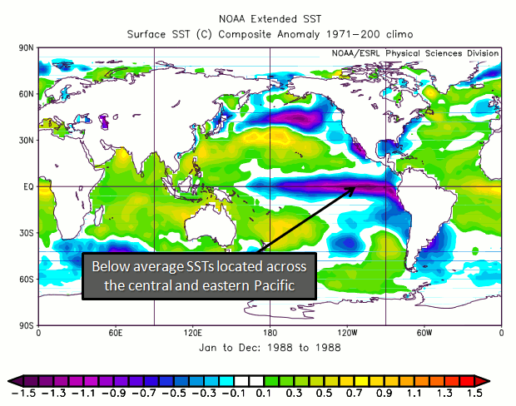
ENSO effect on surface temperature
El Nino La Nina
http://www.nc-climate.ncsu.edu/climate/patterns/ENSO.html
El Nino has anomalously warm cold tongue.
La Nina has anomalously cold cold tongue (hence “super-normal”)

Slide 7
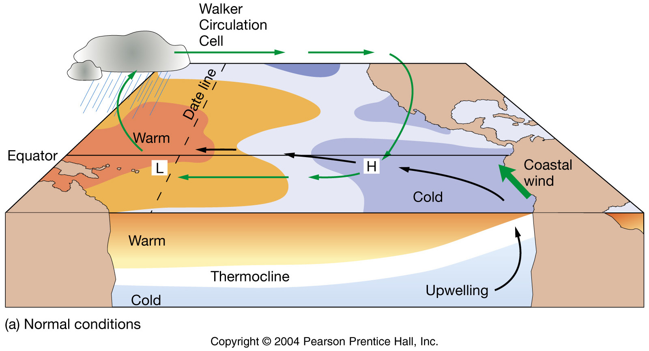
Average tropical Pacific conditions
Known as the Walker cell!
- trade winds blow from East to West
- warm water piles up in West Pacific,
driving deep atmospheric convection
- cold, nutrient-rich water is brought to the
surface in the East Pacific (upwelling)
strong trade
winds
cool in East
warm in West
This system is tightly coupled

Slide 8
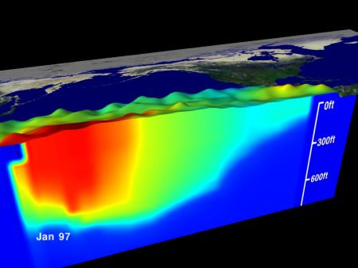
Normal ocean structure
steep thermocline to the east and a warm pool of water to the west

Slide 9
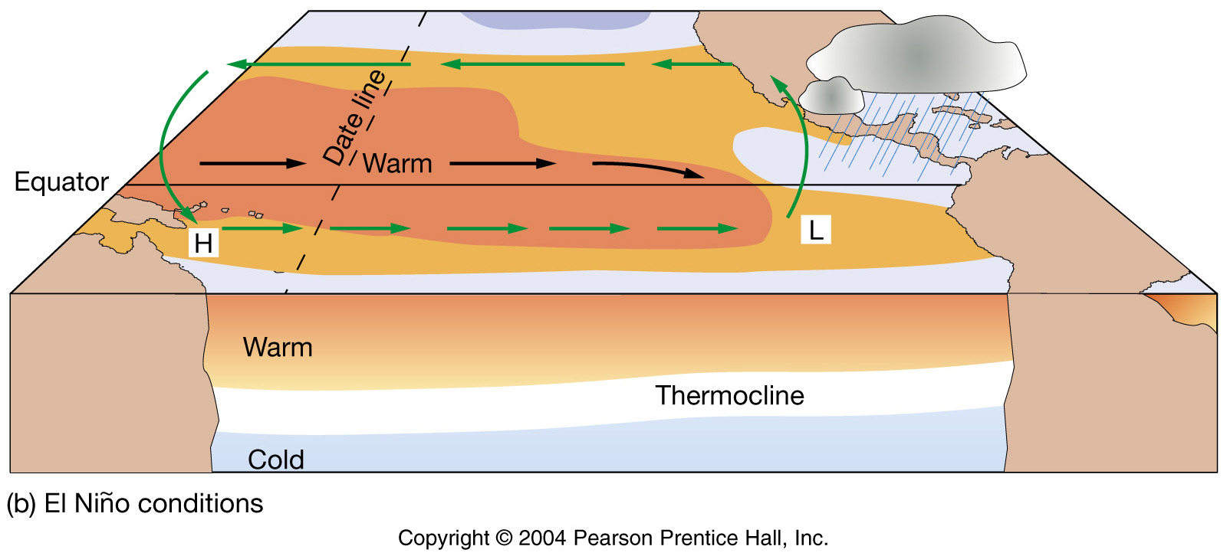
Tropical Pacific conditions during El Niño
Trade winds relax
Warm water moves east
Thermocline deepens
Pressure cells switch
trade winds
weaken
Thermocline deepens
Eastern Pacific
warms
upwelling
slows
The Bjerknes Feedback:

Slide 10
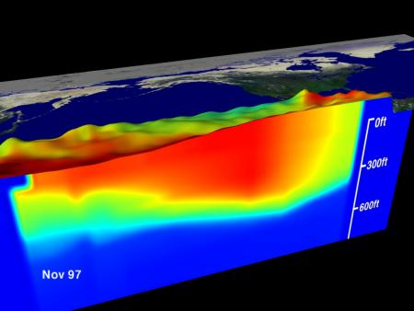
El Nino!

Slide 11
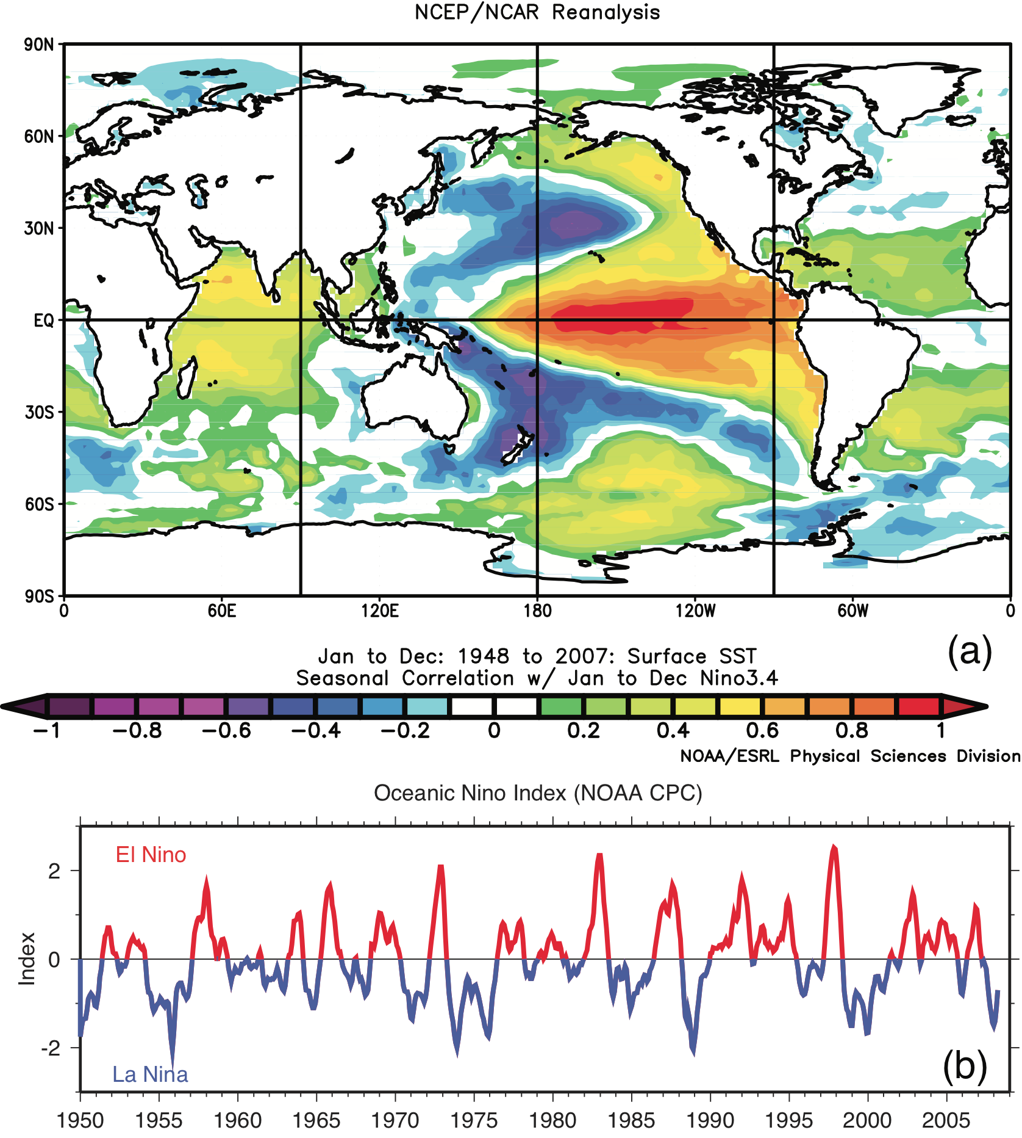
ENSO: SST pattern and index
Correlation of SST with El Niño index (“Nino3.4” index)
Time series of Niño index
DPO Fig. 10.28

Slide 12
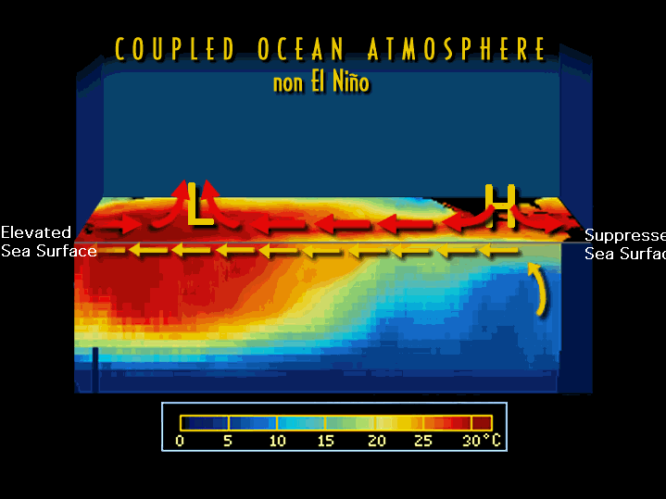
Elevated
Sea Surface
Suppressed
Sea Surface

Slide 13
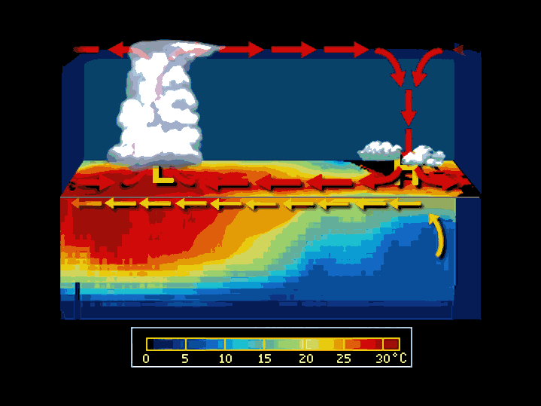

Slide 14
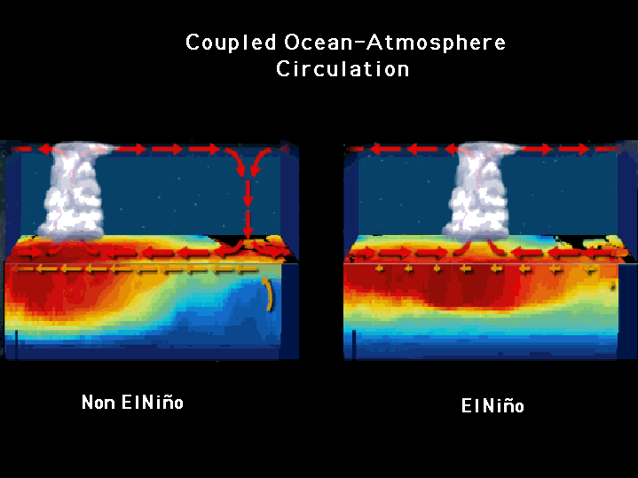
Coupled Ocean-Atmosphere
Circulation

Slide 15
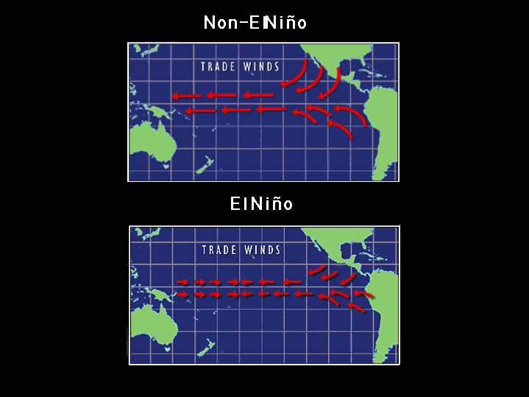
Non El Niño
El Niño

Slide 16
El Niño Characteristics
Normally develops in Western Tropical Pacific
Eastward advection of warm water
Shut down of the upwelling system along South America
Often results in natural disasters
Occurs every 2 to 10 years
Most recent and severe events in 1953, ‘57-’58, ‘65, ‘72-’73, ‘76-’77, ‘82-’83, ‘91-’92, ‘97-’98, ‘02-’03, 06-07

Slide 17
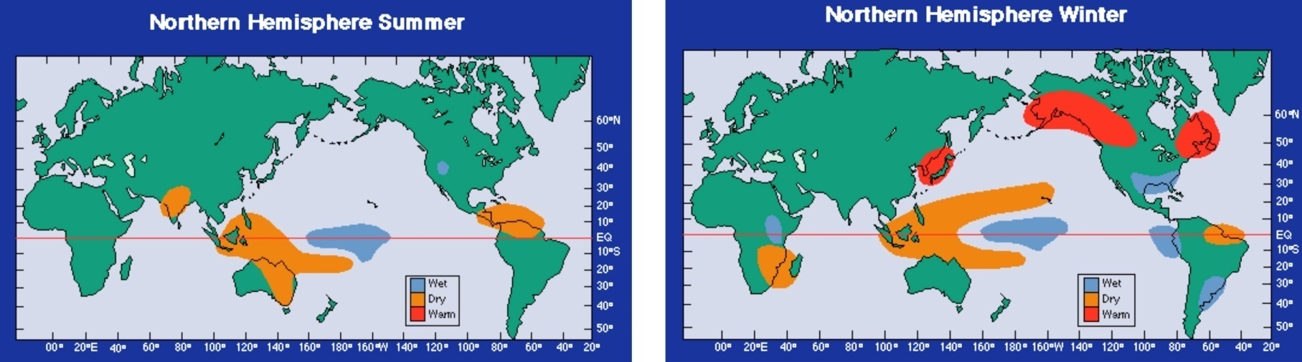
El Nino precipitation changes
FIGURE S10.24
Global precipitation anomalies for Northern Hemisphere summer (left) and winter (right) during
El Niño. Source: From NOAA PMEL (2009d).
DPO Figure S10.24

Slide 18
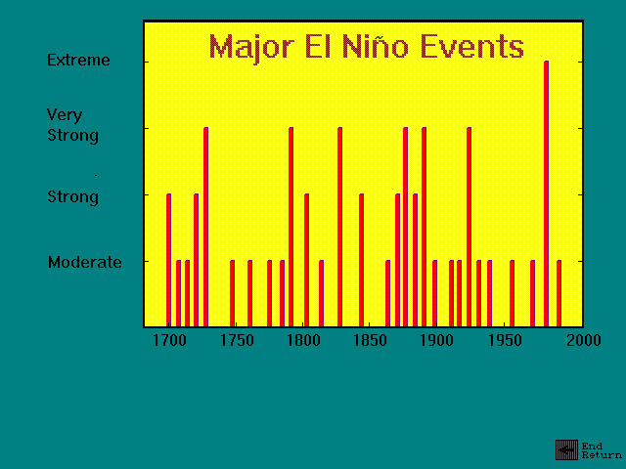

Slide 19
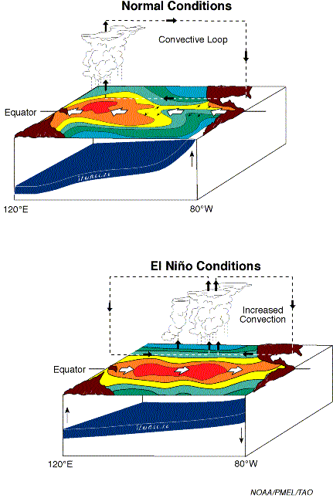
Dynamics IX: ENSO elements in brief (slide 2) El Nino conditions (Bjerknes feedback cont.)
If trade winds weaken, then
Westward surface flow (SEC) weakens, allowing western Pacific warm waters to move eastward
cold tongue in eastern equatorial Pacific warms
Equatorial SST gradient is thus reduced and this further reduces the tradewinds.
This then becomes the El Nino condition.
http://www.pmel.noaa.gov/tao/elnino/nino-home.html)

Slide 20
Signatures of ENSO
Anomalies of:
Winds (El Niño has westerly wind anomalies in western equatorial Pacific)
Atmospheric pressure anomalies (Darwin pressure high, Tahiti pressure lower, so SOI, which is Tahiti minus Darwin, has negative anomaly in El Niño) “Southern Oscillation Index”
SST (El Niño has warm SST in central and eastern equatorial Pacific)
Sea surface height and surface dynamic height (El Niño has high SSH anomaly in central and eastern equatorial Pacific, low SSH anomaly in western equatorial Pacific)
Thermocline depth (El Niño has deep anomaly in east and shallow anomaly in west)

Slide 21
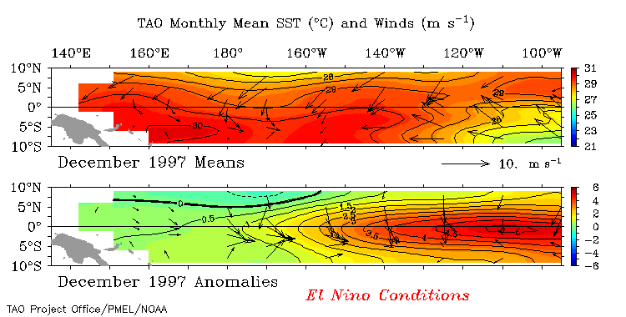
El Niño SST and wind conditions in the tropical Pacific

Slide 22
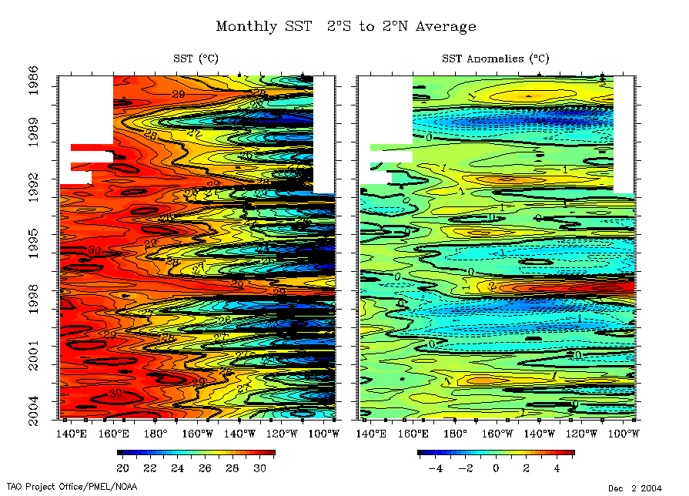
Time series: SST at equator
La Niña
El Niño

Slide 23
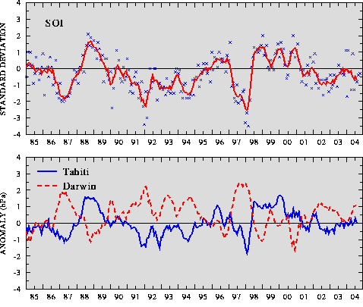
Southern Oscilllation index (NCEP)
El Niños: low SOI
During El Niño:
SOI is low:
Tahiti minus Darwin SLPA is low, meaning that the pressure difference between them is reduced.
Therefore the trade winds are weaker during ENSO.
Note that Darwin and Tahiti anomalies are out of phase
http://www.cpc.ncep.noaa.gov/products/analysis_monitoring/bulletin/index.html

Slide 24
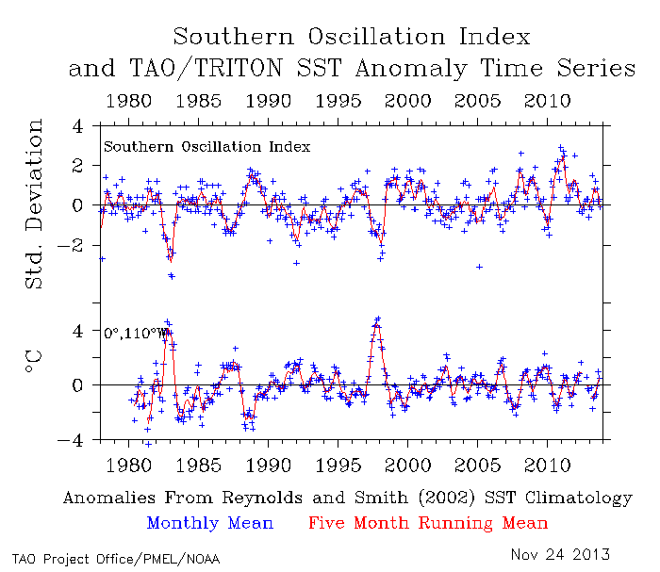
SOI and 110°W temperature time series
http://www.pmel.noaa.gov/tao/jsdisplay/

